Slide 1
Syntactic Parsing
Exercise Session Capita Selecta Course Computer Science: AI
Ruben Cartuyvels, Victor Milewski and Marie-Francine Moens

Slide 2
Overview
Parsing context free grammars (CFG)
Self-supervised latent trees
Semantic role labeling using a GNN
Dependency parsing (optional)
Complexity (optional)
2

Slide 3
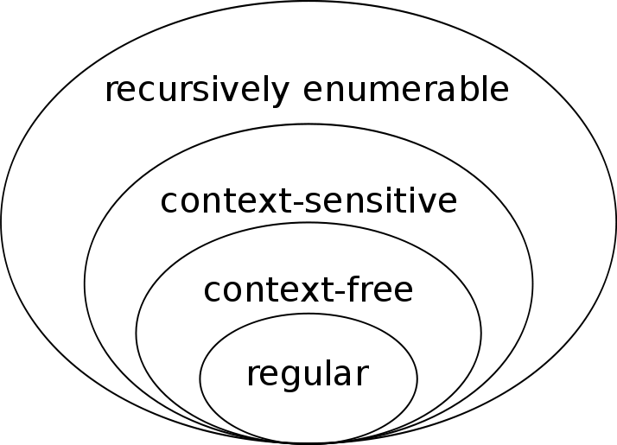
Chomsky Hierarchy
⇒ Relates language expressivity, grammar rules, parsing automata, and worst case parsing complexity
Type | Language | Rules | Automaton | Parsing Complexity
Level 3 | Regular | A → x B A → x | Finite State Automaton | O(n)
Level 2 | Context Free | A → β | Pushdown Automaton | O(n³)
Level 1 | Context Sensitive | α A β → α γ β | Linear Bounded Automaton | NP-complete
Level 0 | Unrestricted | α → β | Turing Machine | Undecidable
3
Notes:
A tiny bit of background about formal grammar theory

Slide 4
Chomsky Hierarchy
⇒ Most languages are considered context free
(*ignoring some discussions about specific languages)
Type | Language | Rules | Automaton | Parsing Complexity
Level 3 | Regular | A → x B A → x | Finite State Automaton | O(n)
Level 2 | Context Free | A → β | Pushdown Automaton | O(n³)
Level 1 | Context Sensitive | α A β → α γ β | Linear Bounded Automaton | NP-complete
Level 0 | Unrestricted | α → β | Turing Machine | Undecidable
4
Notes:
What is so context free about context free grammars? ⇒ The rules can be applied regardless of the context of the condition (A). In contrast to Context sensitive rules, where A is contextualized by α and β.

Slide 5
Context Free Grammars (CFG)
Has production rules consisting of:
A start symbol: S
Non-terminal symbols: A, B, C, … (start with uppercase)
Terminal symbols: a, b, c, … (lowercase)
Production rules can be of the form:
A → β
, where A is a non-terminal, and β is a sequence of terminals and/or non-terminals.
5

Slide 6
Example of a small CFG (with abbreviations)
S → NP VP
NP → D N | NP PP | Pro
VP → V NP | V NP PP
PP → P NP
D → the | a
P → with
Pro → john
N → cat | tree | binoculars
V → sees | climbs
6

Slide 7
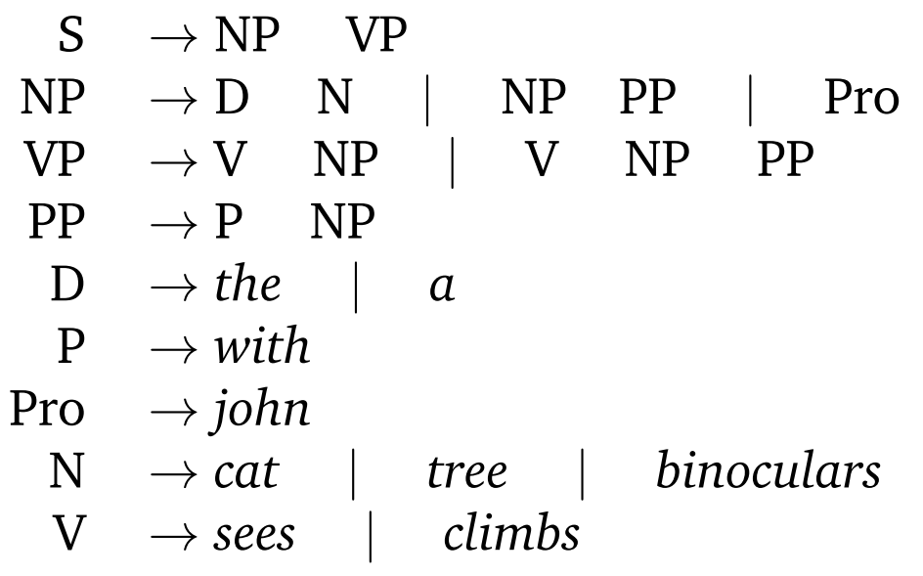
Ex. 1.A Construct two grammatical sentences
7

Slide 8
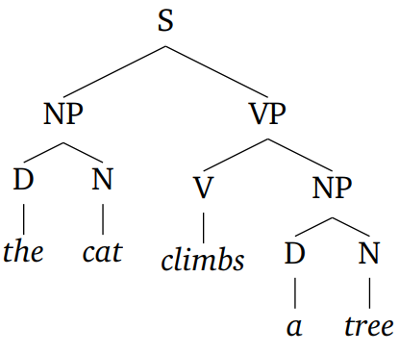
Ex. 1.A Construct two grammatical sentences
8

Slide 9
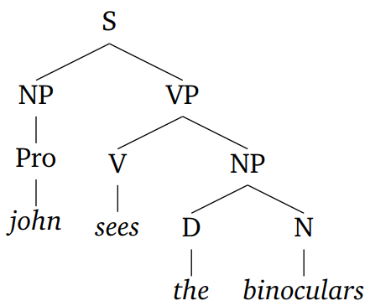
Ex. 1.A Construct two grammatical sentences
9

Slide 10
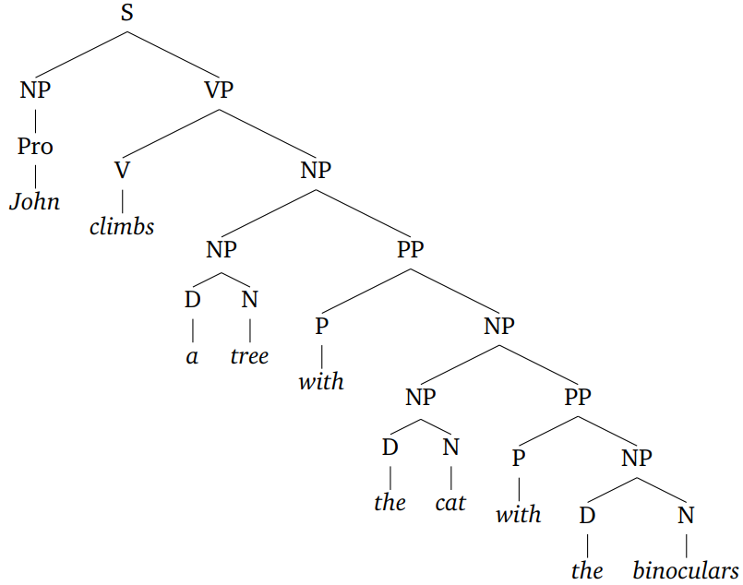
Ex. 1.A Construct two grammatical sentences
10

Slide 11
CYK requires Chomsky Normal Form (CNF)
A CFG is in Chomsky normal form if each rule fits one of the following forms:
A → B C
A → a
S → ε
,where ε is the empty string
11

Slide 12
CYK requires Chomsky Normal Form (CNF)
A CFG is in Chomsky normal form if each rule fits one of the following forms:
A → B C
A → a
S → ε
,where ε is the empty string
Why CNF? Because then each rule directly corresponds to either a unary leaf, or a binary node in a binary tree. (will be more clear later on)
12

Slide 13
Ex. 1.B: Convert this CFG to Chomsky Normal Form
A CFG is in Chomsky normal form if each rule fits one of the following forms:
A → B C
A → a
S → ε
,where ε is the empty string
13

Slide 14
Ex. 1.B: Two issues
14

Slide 15
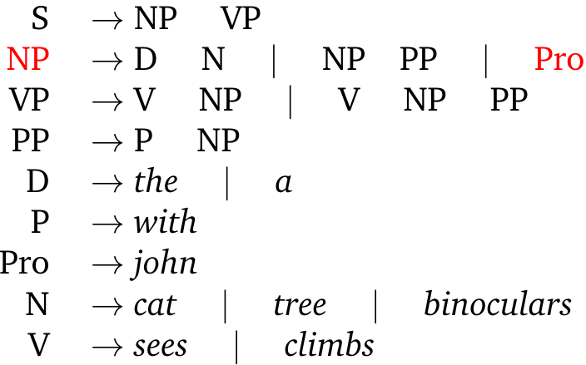
Ex. 1.B: Issue 1 (A→ B)
⇒ Rewrite the right-hand side of the original rules
with the right-hand side of all the non-unit production rules that they ultimately lead to.
15

Slide 16
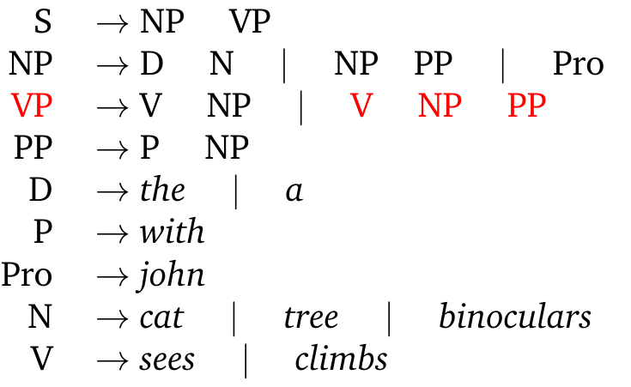
Ex. 1.B: Issues 2 (A→ B C D)
⇒ We replace the leftmost pair of non-terminals with a new non-terminal and introduce a new production result in the following new rules.
16

Slide 17
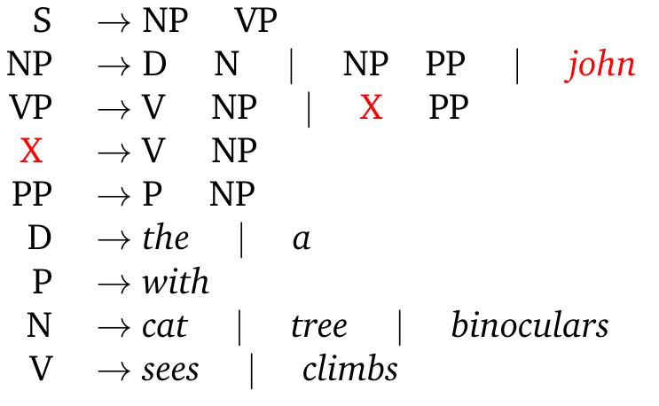
Ex. 1.B: A → B C
17

Slide 18

Ex. 1.B: A → B C
18

Slide 19
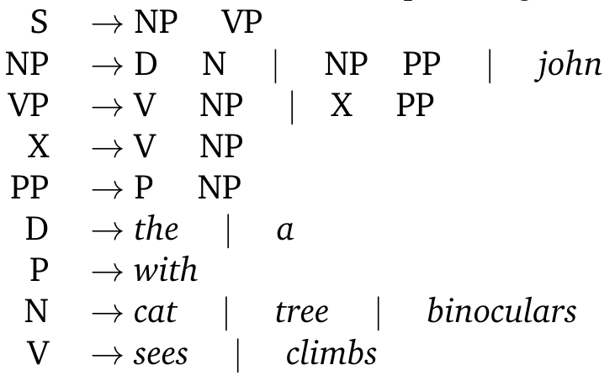
Parsing with CYK Ex 1.C.1
John climbs the tree
19

Slide 20
Construct the table
John climbs the tree
climbs
 | the
 |  | tree
John
⇒ Each cell corresponds to the text span starting from the left-side word, up to the top-side word. We fill it with all non-terminals producible for that span.
20

Slide 21
Construct the table
John climbs the tree
climbs
 | the
 |  | tree
John
⇒ Each cell corresponds to the text span starting from the left-side word, up to the top-side word. We fill it with all non-terminals producible for that span.
21

Slide 22
Construct the table
John climbs the tree
climbs
 | the
 |  | tree
John
⇒ Each cell corresponds to the text span starting from the left-side word, up to the top-side word. We fill it with all non-terminals producible for that span.
22

Slide 23
Construct the table
John climbs the tree
climbs
 | the
 |  | tree
John
⇒ Each cell corresponds to the text span starting from the left-side word, up to the top-side word. We fill it with all non-terminals producible for that span.
23

Slide 24
Construct the table
John climbs the tree
climbs
 | the
 |  | tree
John
⇒ Each cell corresponds to the text span starting from the left-side word, up to the top-side word. We fill it with all non-terminals producible for that span.
24

Slide 25
Construct the table
John climbs the tree
climbs
 | the
 |  | tree
John
⇒ Each cell corresponds to the text span starting from the left-side word, up to the top-side word. We fill it with all non-terminals producible for that span.
25

Slide 26
Construct the table
John climbs the tree
climbs
 | the
 |  | tree
John
⇒ Each cell corresponds to the text span starting from the left-side word, up to the top-side word. We fill it with all non-terminals producible for that span.
26

Slide 27
Construct the table
John climbs the tree
climbs
 | the
 |  | tree
John
⇒ Each cell corresponds to the text span starting from the left-side word, up to the top-side word. We fill it with all non-terminals producible for that span.
27

Slide 28
Construct the table
John climbs the tree
climbs
 | the
 |  | tree
John
⇒ Each cell corresponds to the text span starting from the left-side word, up to the top-side word. We fill it with all non-terminals producible for that span.
28

Slide 29
A grammatical sentence can be produced from S
John climbs the tree
 |  |  | S ?
climbs
 | the
 |  | tree
John
⇒ Each cell corresponds to the text span starting from the left-side word, up to the top-side word. We fill it with all non-terminals producible for that span.
29

Slide 30
2. We start with the single words
John climbs the tree
climbs
 | the
 |  | tree
John
⇒ What non-terminals can produce this span?
30

Slide 31
2. We start with the single words
John climbs the tree
NP
climbs
 | the
 |  | tree
John
⇒ What non-terminals can produce this span?
31

Slide 32
2. We start with the single words
John climbs the tree
NP
climbs | V
 | the
 |  | tree
John
⇒ What non-terminals can produce this span?
32

Slide 33
2. We start with the single words
John climbs the tree
NP
climbs | V
 | the | D
 |  | tree
John
⇒ What non-terminals can produce this span?
33

Slide 34
2. We start with the single words
John climbs the tree
NP
climbs | V
 | the | D
 |  | tree | N
John
⇒ What non-terminals can produce this span?
34

Slide 35
3. Now two-word spans
John climbs the tree
NP
climbs | V
 | the | D
 |  | tree | N
John
⇒ What non-terminals can produce this span?
35

Slide 36
3. Now two-word spans
John climbs the tree
NP | -
climbs | V
 | the | D
 |  | tree | N
John
⇒ What non-terminals can produce this span?
Re-use earlier computation!
36

Slide 37
3. Now two-word spans
John climbs the tree
NP | -
climbs | V | -
 | the | D
 |  | tree | N
John
⇒ What non-terminals can produce this span?
Re-use earlier computation!
37

Slide 38
3. Now two-word spans
John climbs the tree
NP | -
climbs | V | -
 | the | D | NP
 |  | tree | N
John
: [1,D,N]
⇒ What non-terminals can produce this span?
Re-use earlier computation!
38

Slide 39
3. And so on...
John climbs the tree
NP | - | -
climbs | V | -
 | the | D | NP
 |  | tree | N
John
: [1,D,N]
⇒ What non-terminals can produce this span?
Re-use earlier computation!
39

Slide 40
3. And so on...
John climbs the tree
NP | - | -
climbs | V | -
 | the | D | NP
 |  | tree | N
John
: [1,D,N]
⇒ What non-terminals can produce this span?
Re-use earlier computation!
40

Slide 41
3. And so on...
John climbs the tree
NP | - | -
climbs | V | - | VP X
 | the | D | NP
 |  | tree | N
John
: [1,V,NP]
: [1,V,NP]
: [1,D,N]
⇒ What non-terminals can produce this span?
Re-use earlier computation!
41

Slide 42
3. And so on...
John climbs the tree
NP | - | -
climbs | V | - | VP X
 | the | D | NP
 |  | tree | N
John
: [1,V,NP]
: [1,V,NP]
: [1,D,N]
⇒ What non-terminals can produce this span?
Re-use earlier computation!
42

Slide 43
3. And so on...
John climbs the tree
: [1,NP,VP]
NP | - | - | S
climbs | V | - | VP X
 | the | D | NP
 |  | tree | N
John
: [1,V,NP]
: [1,V,NP]
: [1,D,N]
⇒ What non-terminals can produce this span?
Re-use earlier computation!
43

Slide 44
3. And so on...
John climbs the tree
: [1,NP,VP]
NP | - | - | S
climbs | V | - | VP X
 | the | D | NP
 |  | tree | N
John
: [1,V,NP]
: [1,V,NP]
: [1,D,N]
⇒ What non-terminals can produce this span?
Re-use earlier computation!
44

Slide 45
3. And so on...
John climbs the tree
: [1,NP,VP]
NP | - | - | S
climbs | V | - | VP X
 | the | D | NP
 |  | tree | N
John
: [1,V,NP]
: [1,V,NP]
: [1,D,N]
⇒ What non-terminals can produce this span?
Re-use earlier computation!
45

Slide 46
3. Done!
John climbs the tree
: [1,NP,VP]
NP | - | - | S
climbs | V | - | VP X
 | the | D | NP
 |  | tree | N
John
: [1,V,NP]
: [1,V,NP]
: [1,D,N]
We can infer a sentence S!
46

Slide 47
4. What about the tree?
John climbs the tree
: [1,NP,VP]
NP | - | - | S
climbs | V | - | VP X
 | the | D | NP
 |  | tree | N
John
: [1,V,NP]
: [1,V,NP]
: [1,D,N]
47

Slide 48
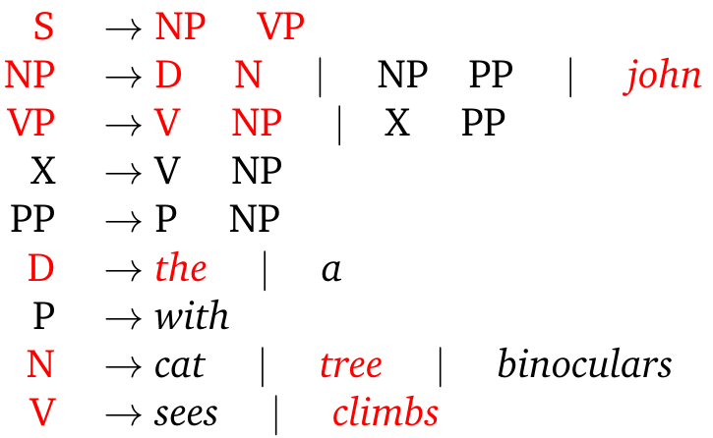
4. What about the tree?
John climbs the tree
: [1,NP,VP]
NP | - | - | S
climbs | V | - | VP X
 | the | D | NP
 |  | tree | N
John
: [1,V,NP]
: [1,V,NP]
: [1,D,N]
Remember the trace of the rules you used to find S!
48

Slide 49
John climbs the tree
Done!
: [1,NP,VP]
NP | - | - | S
climbs | V | - | VP X
 | the | D | NP
 |  | tree | N
John
: [1,V,NP]
: [1,V,NP]
: [1,D,N]
S
VP
NP
NP V D N
John climbs the tree
49

Slide 50
Ex. 1.C.2 Parse this ambiguous sentence using CYK
The cat sees the tree with the binoculars.
50

Slide 51
Ex. 1.C.2* Parse with CYK
the cat sees the tree with the binoculars
the
cat
 | sees
 |  | the
 |  |  | tree
 |  |  |  | with
 |  |  |  |  | the
binoculars
51
Notes:
PP-attachment ambiguity.

Slide 52
Ex. 1.C.2* Parse with CYK
the cat sees the tree with the binoculars
the
D
cat | N
 | sees | V
 |  | the | D
 |  |  | tree | N
 |  |  |  | with | P
 |  |  |  |  | the | D
 |  |  |  |  |  |  | N
binoculars
52
Notes:
PP-attachment ambiguity.

Slide 53
Ex. 1.C.2* Parse with CYK
the cat sees the tree with the binoculars
the
D | NP
cat | N | -
 | sees | V | -
 |  | the | D | NP
 |  |  | tree | N | -
 |  |  |  | with | P | -
 |  |  |  |  | the | D | NP
 |  |  |  |  |  |  | N
: [1,D,N]
: [1,D,N]
: [1,D,N]
binoculars
53
Notes:
PP-attachment ambiguity.

Slide 54
Ex. 1.C.2* Parse with CYK
the cat sees the tree with the binoculars
the
D | NP | -
cat | N | - | -
 | sees | V | - | VP X
 |  | the | D | NP | -
 |  |  | tree | N | - | -
 |  |  |  | with | P | - | PP
 |  |  |  |  | the | D | NP
 |  |  |  |  |  |  | N
: [1,D,N]
: [1,V,NP]
: [1,V,NP]
: [1,D,N]
: [1,P,NP]
: [1,D,N]
binoculars
54
Notes:
PP-attachment ambiguity.

Slide 55
Ex. 1.C.2* Parse with CYK
the cat sees the tree with the binoculars
the
D | NP | - | -
cat | N | - | - | -
 | sees | V | - | VP X | -
 |  | the | D | NP | - | -
 |  |  | tree | N | - | - | -
 |  |  |  | with | P | - | PP
 |  |  |  |  | the | D | NP
 |  |  |  |  |  |  | N
: [1,D,N]
: [1,V,NP]
: [1,V,NP]
: [1,D,N]
: [1,P,NP]
: [1,D,N]
binoculars
55
Notes:
PP-attachment ambiguity.

Slide 56
Ex. 1.C.2* Parse with CYK
the cat sees the tree with the binoculars
the
D | NP | - | - | S
cat | N | - | - | - | -
 | sees | V | - | VP X | - | -
 |  | the | D | NP | - | - | NP
 |  |  | tree | N | - | - | -
 |  |  |  | with | P | - | PP
 |  |  |  |  | the | D | NP
 |  |  |  |  |  |  | N
: [1,D,N]
: [2,NP,VP]
: [1,V,NP]
: [1,V,NP]
: [1,D,N]
: [2,NP,PP]
: [1,P,NP]
: [1,D,N]
binoculars
56
Notes:
PP-attachment ambiguity.

Slide 57
Ex. 1.C.2* Parse with CYK
the cat sees the tree with the binoculars
the
D | NP | - | - | S | -
cat | N | - | - | - | - | -
 | sees | V | - | VP X | - | - | VP X
 |  | the | D | NP | - | - | NP
 |  |  | tree | N | - | - | -
 |  |  |  | with | P | - | PP
 |  |  |  |  | the | D | NP
 |  |  |  |  |  |  | N
: [1,D,N]
: [2,NP,VP]
: [1,V,NP]
: [1,V,NP], [3,X,PP]
: [1,V,NP]
: [1,V,NP]
: [1,D,N]
: [2,NP,PP]
: [1,P,NP]
: [1,D,N]
binoculars
57
Notes:
PP-attachment ambiguity.

Slide 58
Ex. 1.C.2* Parse with CYK
the cat sees the tree with the binoculars
the
D | NP | - | - | S | -
cat | N | - | - | - | - | -
 | sees | V | - | VP, X | - | - | VP X
 |  | the | D | NP | - | - | NP
 |  |  | tree | N | - | - | -
 |  |  |  | with | P | - | PP
 |  |  |  |  | the | D | NP
 |  |  |  |  |  |  | N
: [1,D,N]
: [2,NP,VP]
: [1,V,NP]
: [1,V,NP], [3,X,PP]
: [1,V,NP]
: [1,V,NP]
: [1,D,N]
: [2,NP,PP]
: [1,P,NP]
: [1,D,N]
binoculars
58
Notes:
PP-attachment ambiguity.

Slide 59
Ex. 1.C.2* Parse with CYK
the cat sees the tree with the binoculars
the
D | NP | - | - | S | -
cat | N | - | - | - | - | -
 | sees | V | - | VP, X | - | - | VP X
 |  | the | D | NP | - | - | NP
 |  |  | tree | N | - | - | -
 |  |  |  | with | P | - | PP
 |  |  |  |  | the | D | NP
 |  |  |  |  |  |  | N
: [1,D,N]
: [2,NP,VP]
: [1,V,NP]
: [1,V,NP], [3,X,PP]
: [1,V,NP]
: [1,V,NP]
: [1,D,N]
: [2,NP,PP]
: [1,P,NP]
: [1,D,N]
binoculars
59
59
Notes:
PP-attachment ambiguity.

Slide 60
Ex. 1.C.2* Parse with CYK
the cat sees the tree with the binoculars
the
D | NP | - | - | S | - | -
cat | N | - | - | - | - | - | -
 | sees | V | - | VP, X | - | - | VP X
 |  | the | D | NP | - | - | NP
 |  |  | tree | N | - | - | -
 |  |  |  | with | P | - | PP
 |  |  |  |  | the | D | NP
 |  |  |  |  |  |  | N
: [1,D,N]
: [2,NP,VP]
: [1,V,NP]
: [1,V,NP], [3,X,PP]
: [1,V,NP]
: [1,V,NP]
: [1,D,N]
: [2,NP,PP]
: [1,P,NP]
: [1,D,N]
binoculars
60
60
Notes:
PP-attachment ambiguity.

Slide 61
Ex. 1.C.2* Parse with CYK
the cat sees the tree with the binoculars
the
D | NP | - | - | S | - | - | S
cat | N | - | - | - | - | - | -
 | sees | V | - | VP, X | - | - | VP X
 |  | the | D | NP | - | - | NP
 |  |  | tree | N | - | - | -
 |  |  |  | with | P | - | PP
 |  |  |  |  | the | D | NP
 |  |  |  |  |  |  | N
: [1,D,N]
: [2,NP,VP]
: [2,NP,VP]
: [1,V,NP]
: [1,V,NP], [3,X,PP]
: [1,V,NP]
: [1,V,NP]
: [1,D,N]
: [2,NP,PP]
: [1,P,NP]
: [1,D,N]
binoculars
61
Notes:
PP-attachment ambiguity.

Slide 62
Ex. 1.C.2* Parse with CYK
the cat sees the tree with the binoculars
the
D | NP | - | - | S | - | - | S¹, S²
cat | N | - | - | - | - | - | -
 | sees | V | - | VP, X | - | - | VP X
 |  | the | D | NP | - | - | NP
 |  |  | tree | N | - | - | -
 |  |  |  | with | P | - | PP
 |  |  |  |  | the | D | NP
 |  |  |  |  |  |  | N
binoculars
62
Notes:
PP-attachment ambiguity.

Slide 63
Ex. 1.C.2* Parse with CYK
the cat sees the tree with the binoculars
the
D | NP | - | - | S | - | - | S¹, S²
cat | N | - | - | - | - | - | -
 | sees | V | - | VP, X | - | - | VP X
 |  | the | D | NP | - | - | NP
 |  |  | tree | N | - | - | -
 |  |  |  | with | P | - | PP
 |  |  |  |  | the | D | NP
 |  |  |  |  |  |  | N
binoculars
63
Notes:
PP-attachment ambiguity.

Slide 64
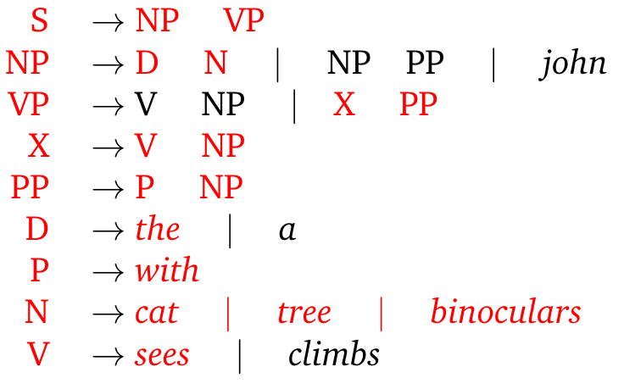
Ex.1.C.2* First reading
S¹
the cat sees the tree with the binoculars
VP
the
D | NP | - | - | S | - | - | S¹, S²
cat | N | - | - | - | - | - | -
 | sees | V | - | VP, X | - | - | VP X
 |  | the | D | NP | - | - | NP
 |  |  | tree | N | - | - | -
 |  |  |  | with | P | - | PP
 |  |  |  |  | the | D | NP
 |  |  |  |  |  |  | N
X
PP
NP
NP
NP
D N V D N P D N
the cat sees the tree with the binoculars.
binoculars
64
Notes:
PP-attachment ambiguity.

Slide 65

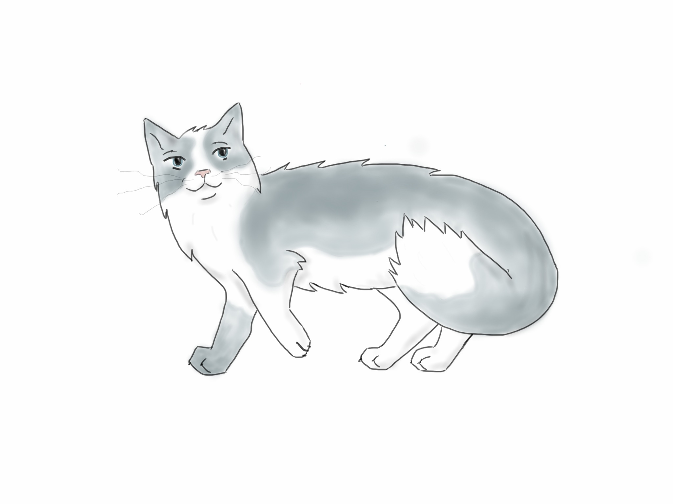

First Reading
The cat sees the tree with the binoculars.
(1)
(2)
65
Notes:
PP-attachment ambiguity.

Slide 66
Second Reading
The cat sees the tree with the binoculars.
(1)
(2)
66
Notes:
PP-attachment ambiguity.

Slide 67
Overview
Parsing context free grammars (CFG)
Self-supervised latent trees
Semantic role labeling using a GNN
Dependency parsing (optional)
Complexity (optional)
67

Slide 68
Inside/outside recursion
I saw an elephant
Drozdov, A., Verga, P., Yadav, M., Iyyer, M., & Mccallum, A. (2019). Unsupervised Latent Tree Induction with Deep Inside-Outside Recursive Auto-Encoders. In Proceedings of the 2019 Conference of the North American Chapter of the Association for Computational Linguistics: Human Language Technologies, Volume 1 (Long and Short Papers) (pp. 1129-1141).
Same order as CKY
saw
 | an
 |  | elephant
I
68

Slide 69
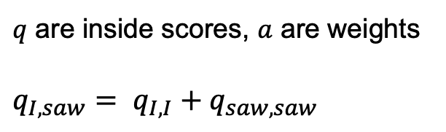
Inside/outside recursion
I saw an elephant
$q$ are inside scores, $a$ are weights
$$q_{I,saw}= q_{I, I}+q_{saw,saw}$$
saw
 | an
 |  | elephant
I
69

Slide 70
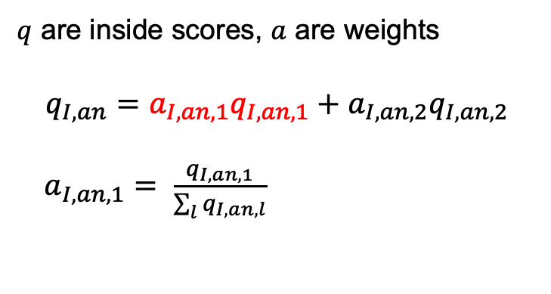
Inside/outside recursion
I saw an elephant
$q$ are inside scores, $a$ are weights
$$q_{I,an}=a_{I,an,1}q_{I,an,1}+{a_{I,an,2}q}_{I,an,2}$$
$a_{I,an,1}= \frac{q_{I,an,1}}{\sum_{l}{q_{I,an,l}}}$
saw
 | an
 |  | elephant
I
70

Slide 71
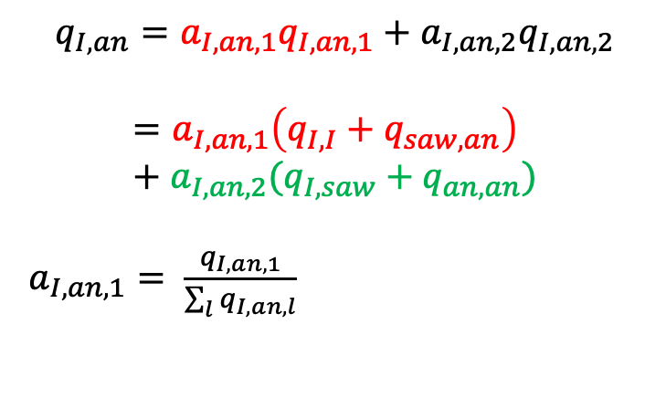
Inside/outside recursion
I saw an elephant
$$q_{I,an}=a_{I,an,1}q_{I,an,1}+{a_{I,an,2}q}_{I,an,2}$$
$$=a_{I,an,1}\left(q_{I, I}+q_{saw,an}\right) +a_{I,an,2}(q_{I, saw}+q_{an,an})$$
$a_{I,an,1}= \frac{q_{I,an,1}}{\sum_{l}{q_{I,an,l}}}$
saw
 | an
 |  | elephant
I
71

Slide 72
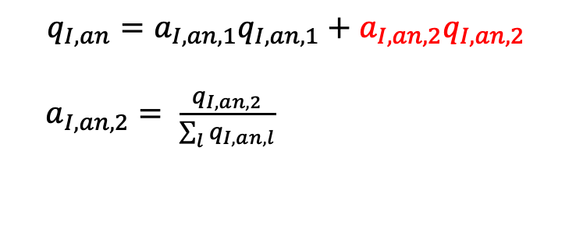
Inside/outside recursion
I saw an elephant
$$q_{I,an}=a_{I,an,1}q_{I,an,1}+{a_{I,an,2}q}_{I,an,2}$$
$a_{I,an,2}= \frac{q_{I,an,2}}{\sum_{l}{q_{I,an,l}}}$
saw
 | an
 |  | elephant
I
72

Slide 73
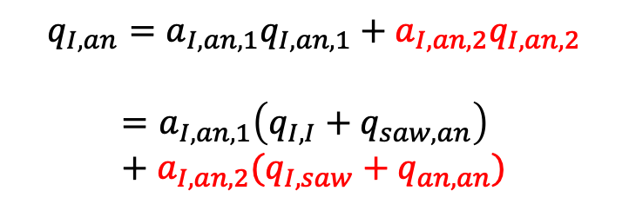
Inside/outside recursion
I saw an elephant
$$q_{I,an}=a_{I,an,1}q_{I,an,1}+{a_{I,an,2}q}_{I,an,2}$$
$$=a_{I,an,1}\left(q_{I, I}+q_{saw,an}\right) +a_{I,an,2}(q_{I, saw}+q_{an,an})$$
saw
 | an
 |  | elephant
I
73

Slide 74
Inside/outside recursion
I saw an elephant
-1
saw | -2
 | an | -5
 |  | elephant | -7
I
74

Slide 75
Inside/outside recursion
I
saw
 | an
 |  | elephant
Inside scores:
Outside scores:
Opposite order as CKY, start from root
I saw an elephant
I
 |  |  | 0
saw
 | an
 |  | elephant
Outside scores:
75

Slide 76
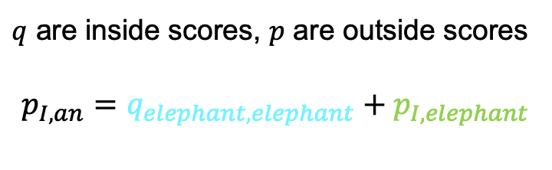
Inside/outside recursion
I
saw
 | an
 |  | elephant
Inside scores:
$q$ are inside scores, $p$ are outside scores
$$p_{I,an}=q_{elephant,elephant}+p_{I,elephant}$$
I saw an elephant
p(I,elephant)
 |  |  | 0
saw
 | an
 |  | elephant
I
p(I,an)
Outside scores:
…
I saw an q(elephant,elephant)
76

Slide 77
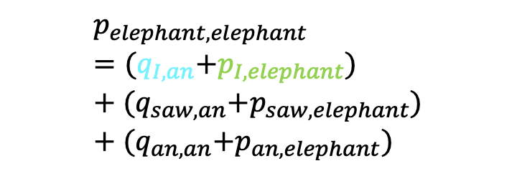
Inside/outside recursion
I
saw
 | an
 |  | elephant
Inside scores:
$$p_{elephant,elephant}={(q}_{I,an}+p_{I,elephant})+{(q}_{saw,an}+p_{saw,elephant})+{(q}_{an,an}+p_{an,elephant})$$
I saw an elephant
p(I,elephant)
I
 |  |  | 0
saw
 | an
 |  | elephant
Outside scores:
q(I,an)
…
I saw an p(elephant,elephant)
77

Slide 78
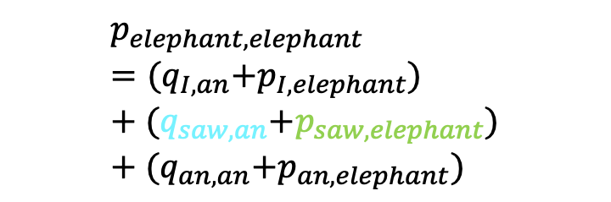
Inside/outside recursion
I
saw
 | an
 |  | elephant
Inside scores:
$$p_{elephant,elephant}={(q}_{I,an}+p_{I,elephant})+{(q}_{saw,an}+p_{saw,elephant})+{(q}_{an,an}+p_{an,elephant})$$
I saw an elephant
root
I
 |  |  | 0
saw
 | an
 |  | elephant
p(saw,elephant)
Outside scores:
…
q(saw,an)
…
I saw an p(elephant,elephant)
78

Slide 79
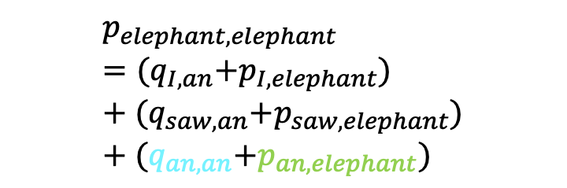
Inside/outside recursion
I
saw
 | an
 |  | elephant
Inside scores:
$$p_{elephant,elephant}={(q}_{I,an}+p_{I,elephant})+{(q}_{saw,an}+p_{saw,elephant})+{(q}_{an,an}+p_{an,elephant})$$
I saw an elephant
root
I
 |  |  | 0
saw
 | an
 |  | elephant
…
Outside scores:
…
…
p(an,elephant)
I saw q(an,an) p(elephant,elephant)
79

Slide 80
Overview
Parsing context free grammars (CFG)
Self-supervised latent trees
Semantic role labeling using a GNN
Dependency parsing (optional)
Complexity (optional)
80

Slide 81
Dependency Trees
⇒ Based on heads and dependents: Every dependent has only 1 head
⇒ Relate words instead of phrases
S
VP
root
NP
subj
obj
det
NP V D N
John climbs the tree
NP V D N
John climbs the tree
81
Notes:
http://nlp.stanford.edu:8080/corenlp/

Slide 82
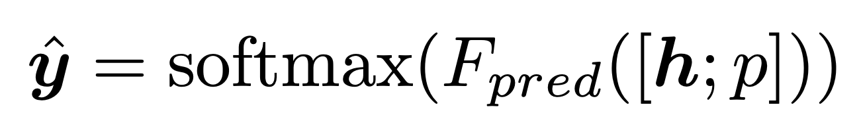
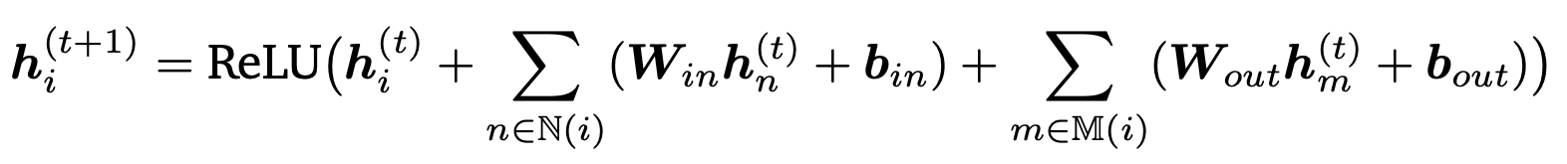
Semantic role labeling using a GNN

Slide 83
Ex. 3.1: Defining the graph with all connections
83

Slide 84
Ex. 3.1: Defining the graph with all connections
binoculars
0
0
0
the
the
tree
with
the
cat
sees
0
0
0
84
0

Slide 85
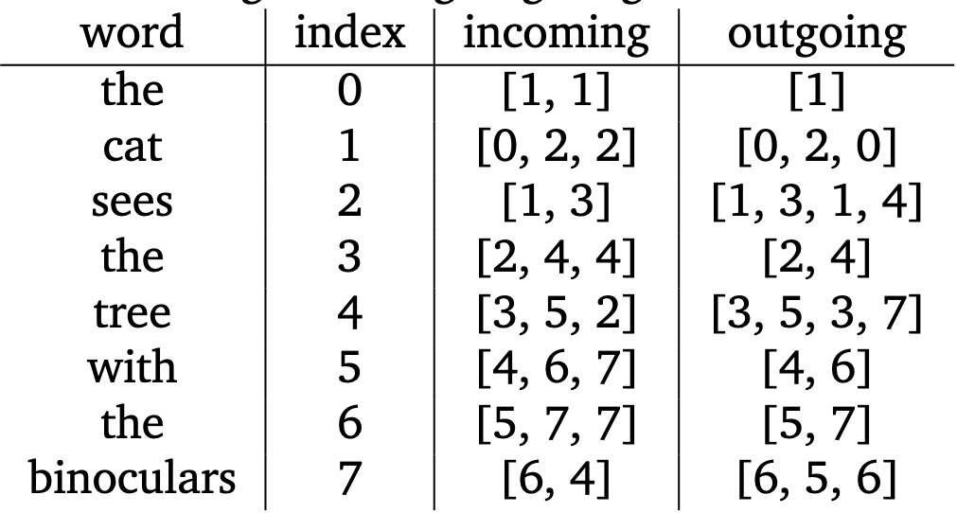
Ex. 3.1: Defining the graph with all connections
binoculars
0
0
0
the
the
tree
with
the
cat
sees
0
0
0
85
0

Slide 86
Ex. 3.2: Create the h⁰
86

Slide 87
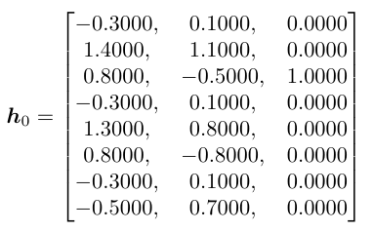
Ex. 3.2: Create the h⁰
87

Slide 88
Ex. 3.2: Compute updates h¹
88

Slide 89
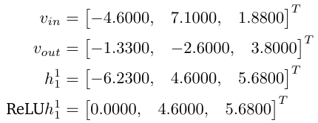
Ex. 3.2: Compute update word 1 - the
89

Slide 90
Ex. 3.2: Compute update word 2 - cat
90

Slide 91
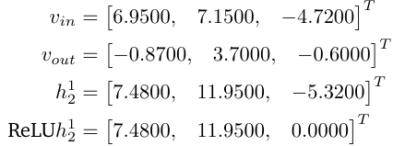
Ex. 3.2: Compute update word 2 - cat
91

Slide 92
Ex. 3.2: Compute update word 3 - sees
92

Slide 93
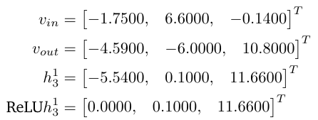
Ex. 3.2: Compute update word 3 - sees
93

Slide 94
Ex. 3.2: Compute update word 4 - the
94

Slide 95
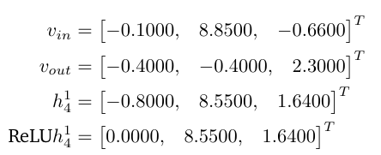
Ex. 3.2: Compute update word 4 - the
95

Slide 96
Ex. 3.2: Compute update word 5 - tree
96

Slide 97
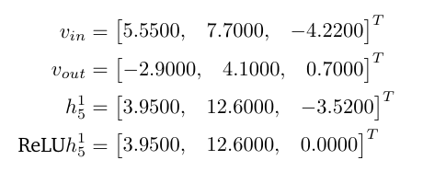
Ex. 3.2: Compute update word 5 - tree
97

Slide 98
Ex. 3.2: Compute update word 6 - with
98

Slide 99
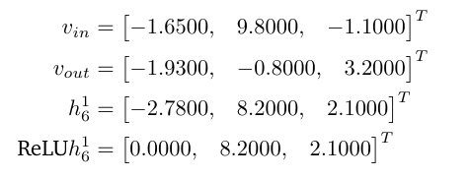
Ex. 3.2: Compute update word 6 - with
99

Slide 100
Ex. 3.2: Compute update word 7 - the
100

Slide 101
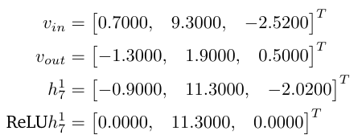
Ex. 3.2: Compute update word 7 - the
101

Slide 102
Ex. 3.2: Compute update word 8 - binoculars
102

Slide 103
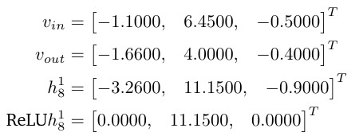
Ex. 3.2: Compute update word 8 - binoculars
103

Slide 104
Ex. 3.3: Compute the prediction
104

Slide 105
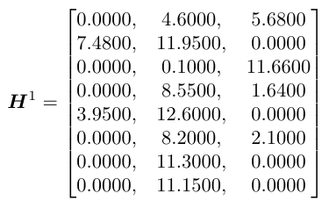
Ex. 3.3: We combine all h¹ into a matrix
105

Slide 106
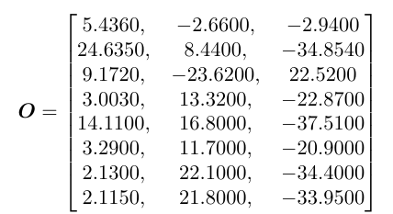
Ex. 3.3: Compute the output
106

Slide 107
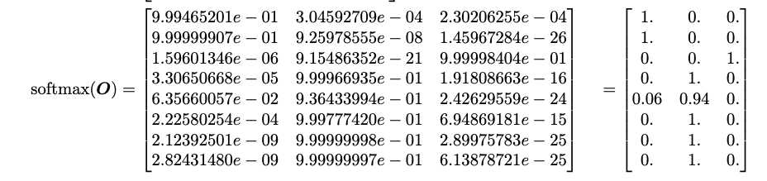
Ex. 3.3: And compute the softmax for each word/row
107

Slide 108
Ex. 3.3: The resulting predictions are
108

Slide 109
Overview
Parsing context free grammars (CFG)
Self-supervised latent trees
Semantic role labeling using a GNN
Dependency parsing (optional)
Complexity (optional)
109

Slide 110
Dependency Trees
⇒ Based on heads and dependents: Every dependent has only 1 head
⇒ Relate words instead of phrases
S
VP
root
NP
subj
obj
det
NP V D N
John climbs the tree
NP V D N
John climbs the tree
110
Notes:
http://nlp.stanford.edu:8080/corenlp/

Slide 111
Parsing Models
For each sentence:
⇒ Score possible dependency structures (trees)
⇒ Parsing corresponds to finding the dependency tree with the highest score
Edge-factored Models:
⇒ The score of a tree is the sum of scores of all edges that comprise the tree
(makes prediction easier)
111

Slide 112
Parsing with Edge-factored Models
All possible edges* receive a score based on the model
root
2
1
John
0
tree
2
4
0
1
7
2
1
2
9
6
1
the
1
climbs
1
* We ignore edge labels to keep the example readable
112

Slide 113
Parsing with Edge-factored Models
All possible edges* receive a score based on the model
Find the maximum spanning tree (MST)
Chu-Liu Edmonds Algorithm (CLE)
O(n²)
root
2
1
John
0
tree
2
4
0
1
7
2
1
2
9
6
1
the
1
climbs
1
* We ignore edge labels to keep the example readable
113

Slide 114
CLE Algorithm: MST(G=(V,E), root, score)
Pick the highest incoming edge for each node in V
scores’ ⇐ Subtract best edge scores from all incoming edges
If no cycles:
0-edges constitute the MST
Else:
C ⇐ cycle
G’ ⇐ Contract(G,C)
T’ ⇐ MST(G’, root, scores’)
T ⇐ Expand(T’, C)
root
2
1
John
0
tree
2
4
0
1
7
2
1
2
9
6
1
the
1
climbs
1
114

Slide 115
CLE Algorithm: MST(G=(V,E), root, score)
Pick the highest incoming edge for each node in V
scores’ ⇐ Subtract best edge scores from all incoming edges
If no cycles:
0-edges constitute the MST
Else:
C ⇐ cycle
G’ ⇐ Contract(G,C)
T’ ⇐ MST(G’, root, scores’)
T ⇐ Expand(T’, C)
root
2
1
John
0
tree
2
4
0
1
7
2
1
2
9
6
1
the
1
climbs
1
115

Slide 116
CLE Algorithm: MST(G=(V,E), root, score)
Pick the highest incoming edge for each node in V
scores’ ⇐ Subtract best edge scores from all incoming edges
If no cycles:
0-edges constitute the MST
Else:
C ⇐ cycle
G’ ⇐ Contract(G,C)
T’ ⇐ MST(G’, root, scores’)
T ⇐ Expand(T’, C)
root
2
1
John
0
tree
2
4
0
1
7
2
1
2
9
6
1
the
1
climbs
1
116

Slide 117
CLE Algorithm: MST(G=(V,E), root, score)
Pick the highest incoming edge for each node in V
scores’ ⇐ Subtract best edge scores from all incoming edges
If no cycles:
0-edges constitute the MST
Else:
C ⇐ cycle
G’ ⇐ Contract(G,C)
T’ ⇐ MST(G’, root, scores’)
T ⇐ Expand(T’, C)
root
2
1
John
0
tree
2
4
0
1
7
2
1
2
9
6
1
the
1
climbs
1
117

Slide 118
CLE Algorithm: MST(G=(V,E), root, score)
Pick the highest incoming edge for each node in V
scores’ ⇐ Subtract best edge scores from all incoming edges
If no cycles:
0-edges constitute the MST
Else:
C ⇐ cycle
G’ ⇐ Contract(G,C)
T’ ⇐ MST(G’, root, scores’)
T ⇐ Expand(T’, C)
root
2
1
John
0
tree
2
4
0
1
7
2
1
2
9
6
1
the
1
climbs
1
118

Slide 119
CLE Algorithm: MST(G=(V,E), root, score)
Pick the highest incoming edge for each node in V
scores’ ⇐ Subtract best edge scores from all incoming edges
If no cycles:
0-edges constitute the MST
Else:
C ⇐ cycle
G’ ⇐ Contract(G,C)
T’ ⇐ MST(G’, root, scores’)
T ⇐ Expand(T’, C)
root
-2
-8
John
-9
tree
-2
0
-9
-5
0
-2
-6
-4
0
0
-6
the
-5
climbs
-6
119

Slide 120
CLE Algorithm: MST(G=(V,E), root, score)
Pick the highest incoming edge for each node in V
scores’ ⇐ Subtract best edge scores from all incoming edges
If no cycles:
0-edges constitute the MST
Else:
C ⇐ cycle
G’ ⇐ Contract(G,C)
T’ ⇐ MST(G’, root, scores’)
T ⇐ Expand(T’, C)
root
-2
-8
John
-9
tree
-2
0
-9
-5
0
-2
-6
-4
0
0
-6
the
-5
climbs
-6
120

Slide 121
What about cycles?
Pick the highest incoming edge for each node in V
scores’ ⇐ Subtract best edge scores from all incoming edges
If no cycles:
0-edges constitute the MST
Else:
C ⇐ cycle
G’ ⇐ Contract(G,C)
T’ ⇐ MST(G’, root, scores’)
T ⇐ Expand(T’, C)
root
2
1
John
0
tree
2
4
0
1
7
2
1
2
9
6
1
the
1
climbs
1
121

Slide 122
Let’s make a cycle to see
Pick the highest incoming edge for each node in V
scores’ ⇐ Subtract best edge scores from all incoming edges
If no cycles:
0-edges constitute the MST
Else:
C ⇐ cycle
G’ ⇐ Contract(G,C)
T’ ⇐ MST(G’, root, scores’)
T ⇐ Expand(T’, C)
root
2
1
John
0
tree
2
4
0
1
7
2
1
9
9
6
1
the
1
climbs
1
122
Notes:
Let’s change 1 score value

Slide 123
Let’s make a cycle to see
Pick the highest incoming edge for each node in V
scores’ ⇐ Subtract best edge scores from all incoming edges
If no cycles:
0-edges constitute the MST
Else:
C ⇐ cycle
G’ ⇐ Contract(G,C)
T’ ⇐ MST(G’, root, scores’)
T ⇐ Expand(T’, C)
root
-2
-8
John
-9
tree
-2
0
-9
-8
0
-4
-6
0
0
-3
-6
the
-8
climbs
-6
123

Slide 124
So how do we contract?
Pick the highest incoming edge for each node in V
scores’ ⇐ Subtract best edge scores from all incoming edges
If no cycles:
0-edges constitute the MST
Else:
C ⇐ cycle
G’ ⇐ Contract(G,C)
T’ ⇐ MST(G’, root, scores’)
T ⇐ Expand(T’, C)
root
-2
-8
John
-9
tree
-2
0
-9
-8
0
-4
-6
-3
-6
the
climbs
⇒ We construct a contracted node C that has the union of
all incoming and outgoing edges of tree and climbs
-8
-6
124

Slide 125
Find the MST for this new graph G’
Pick the highest incoming edge for each node in V
scores’ ⇐ Subtract best edge scores from all incoming edges
If no cycles:
0-edges constitute the MST
Else:
C ⇐ cycle
G’ ⇐ Contract(G,C)
T’ ⇐ MST(G’, root, scores’)
T ⇐ Expand(T’, C)
root
-2
-8
John
-9
tree
-2
0
-9
-8
0
-4
-6
-3
-6
the
-8
climbs
-6
125

Slide 126
Find the MST for this new graph G’
Pick the highest incoming edge for each node in V
scores’ ⇐ Subtract best edge scores from all incoming edges
If no cycles:
0-edges constitute the MST
Else:
C ⇐ cycle
G’ ⇐ Contract(G,C)
T’ ⇐ MST(G’, root, scores’)
T ⇐ Expand(T’, C)
root
-2
-8
John
-9
tree
-2
0
-9
-8
0
-4
-6
-3
-6
the
-8
climbs
-6
126

Slide 127
Find the MST for this new graph G’
Pick the highest incoming edge for each node in V
scores’ ⇐ Subtract best edge scores from all incoming edges
If no cycles:
0-edges constitute the MST
Else:
C ⇐ cycle
G’ ⇐ Contract(G,C)
T’ ⇐ MST(G’, root, scores’)
T ⇐ Expand(T’, C)
root
-2
-8
John
-9
tree
-2
0
-9
-8
0
-4
-6
-3
-6
the
-8
climbs
-6
127

Slide 128
Find the MST for this new graph G’
Pick the highest incoming edge for each node in V
scores’ ⇐ Subtract best edge scores from all incoming edges
If no cycles:
0-edges constitute the MST
Else:
C ⇐ cycle
G’ ⇐ Contract(G,C)
T’ ⇐ MST(G’, root, scores’)
T ⇐ Expand(T’, C)
root
-2
-5
John
-6
tree
-2
0
-6
-5
0
-4
-6
0
-6
the
-5
climbs
-6
128

Slide 129
Expand the cycle
Pick the highest incoming edge for each node in V
scores’ ⇐ Subtract best edge scores from all incoming edges
If no cycles:
0-edges constitute the MST
Else:
C ⇐ cycle
G’ ⇐ Contract(G,C)
T’ ⇐ MST(G’, root, scores’)
T ⇐ Expand(T’, C)
root
-2
-5
John
-6
tree
-2
0
-6
-5
0
-4
-6
0
-6
the
-5
climbs
-6
129

Slide 130
Expand the cycle
Pick the highest incoming edge for each node in V
scores’ ⇐ Subtract best edge scores from all incoming edges
If no cycles:
0-edges constitute the MST
Else:
C ⇐ cycle
G’ ⇐ Contract(G,C)
T’ ⇐ MST(G’, root, scores’)
T ⇐ Expand(T’, C)
root
-2
-5
John
-6
tree
-2
0
-6
-5
0
-4
-6
0
-6
the
-5
climbs
⇒ Only one possibility, as climbs now has an
incoming edge but tree does not
-6
130

Slide 131
Ex. 4 Find the MST for these scores:
Pick the highest incoming edge for each node in V
scores’ ⇐ Subtract best edge scores from all incoming edges
If no cycles:
0-edges constitute the MST
Else:
C ⇐ cycle
G’ ⇐ Contract(G,C)
T’ ⇐ MST(G’, root, scores’)
T ⇐ Expand(T’, C)
root
3
binoculars
3
1
8
5
3
4
2
3
4
1
2
the
4
6
with
the
cat
sees
the
tree
3
3
131
3
5
3

Slide 132
Ex. 4 Find the MST for these scores:
Pick the highest incoming edge for each node in V
scores’ ⇐ Subtract best edge scores from all incoming edges
If no cycles:
0-edges constitute the MST
Else:
C ⇐ cycle
G’ ⇐ Contract(G,C)
T’ ⇐ MST(G’, root, scores’)
T ⇐ Expand(T’, C)
root
3
binoculars
3
1
8
5
3
4
2
3
4
1
2
the
4
6
with
the
cat
sees
the
tree
3
3
132
3
5
3

Slide 133
Ex. 4 Find the MST for these scores:
Pick the highest incoming edge for each node in V
scores’ ⇐ Subtract best edge scores from all incoming edges
If no cycles:
0-edges constitute the MST
Else:
C ⇐ cycle
G’ ⇐ Contract(G,C)
T’ ⇐ MST(G’, root, scores’)
T ⇐ Expand(T’, C)
root
-2
binoculars
-2
-7
0
0
-2
0
-3
0
0
-2
-2
the
-1
-2
with
the
cat
sees
the
tree
0
-1
133
0
0
-1

Slide 134
Ex. 4 Find the MST for these scores:
Pick the highest incoming edge for each node in V
scores’ ⇐ Subtract best edge scores from all incoming edges
If no cycles:
0-edges constitute the MST
Else:
C ⇐ cycle
G’ ⇐ Contract(G,C)
T’ ⇐ MST(G’, root, scores’)
T ⇐ Expand(T’, C)
root
-2
binoculars
-2
-7
0
0
-2
0
-3
0
0
-2
-2
the
-1
-2
with
the
cat
sees
the
tree
0
-1
134
0
0
-1

Slide 135
Ex. 4 Find the MST for these scores:
Pick the highest incoming edge for each node in V
scores’ ⇐ Subtract best edge scores from all incoming edges
If no cycles:
0-edges constitute the MST
Else:
C ⇐ cycle
G’ ⇐ Contract(G,C)
T’ ⇐ MST(G’, root, scores’)
T ⇐ Expand(T’, C)
root
-2
binoculars
-2
-7
0
-2
-3
0
0
-2
-2
the
-1
-2
with
the
cat
sees
the
tree
0
-1
135
0
0
-1

Slide 136
Ex. 4 Find the MST for these scores:
Pick the highest incoming edge for each node in V
scores’ ⇐ Subtract best edge scores from all incoming edges
If no cycles:
0-edges constitute the MST
Else:
C ⇐ cycle
G’ ⇐ Contract(G,C)
T’ ⇐ MST(G’, root, scores’)
T ⇐ Expand(T’, C)
root
-2
binoculars
-2
-7
0
-2
-3
0
0
-2
-2
the
-1
-2
with
the
cat
sees
the
tree
0
-1
136
0
0
-1

Slide 137
Ex. 4 Find the MST for these scores:
Pick the highest incoming edge for each node in V
scores’ ⇐ Subtract best edge scores from all incoming edges
If no cycles:
0-edges constitute the MST
Else:
C ⇐ cycle
G’ ⇐ Contract(G,C)
T’ ⇐ MST(G’, root, scores’)
T ⇐ Expand(T’, C)
root
-2
binoculars
-2
-7
0
-2
-3
0
0
-2
-2
the
-1
-2
with
the
cat
sees
the
tree
0
-1
137
0
0
-1

Slide 138
Ex. 4 Find the MST for these scores:
Pick the highest incoming edge for each node in V
scores’ ⇐ Subtract best edge scores from all incoming edges
If no cycles:
0-edges constitute the MST
Else:
C ⇐ cycle
G’ ⇐ Contract(G,C)
T’ ⇐ MST(G’, root, scores’)
T ⇐ Expand(T’, C)
root
-1
binoculars
-1
-7
0
-2
-2
0
0
-2
-1
the
-1
-2
with
the
cat
sees
the
tree
0
-1
138
0
0
0

Slide 139
Ex. 4 Find the MST for these scores:
Pick the highest incoming edge for each node in V
scores’ ⇐ Subtract best edge scores from all incoming edges
If no cycles:
0-edges constitute the MST
Else:
C ⇐ cycle
G’ ⇐ Contract(G,C)
T’ ⇐ MST(G’, root, scores’)
T ⇐ Expand(T’, C)
root
-1
binoculars
-1
-7
0
-2
-2
0
0
-2
-1
the
-1
-2
with
the
cat
sees
the
tree
0
-1
139
0
0
0

Slide 140
Ex. 4 Find the MST for these scores:
Pick the highest incoming edge for each node in V
scores’ ⇐ Subtract best edge scores from all incoming edges
If no cycles:
0-edges constitute the MST
Else:
C ⇐ cycle
G’ ⇐ Contract(G,C)
T’ ⇐ MST(G’, root, scores’)
T ⇐ Expand(T’, C)
root
-1
binoculars
-1
-7
0
-2
0
-2
0
0
-2
-1
the
-1
-2
with
the
cat
sees
the
tree
0
-1
140
0
0
0

Slide 141
Ex. 4
The cat sees the tree with the binoculars.
(2)
root
binoculars
0
0
0
0
the
the
tree
with
the
cat
sees
0
0
0
141
0

Slide 142
Ex. 4
The cat sees the tree with the binoculars.
root
(2)
sees
cat
tree
the
the
binoculars
with
the
142

